Slide 1


Slide 2



Slide 3

RE/LAUNCHING YOUR BUSINESS
THANKS TO VIPs

Slide 4



OPPORTUNITY TO CREATE A BUZZ
BUILD RELATIONSHIPS & LOYALTY
ATTRACT NEW CLIENTS

Slide 5



CREATE mini REPRESENTATIVES
PROMOTE YOUR PRODUCTS/SERVICES
DRIVE TO ACTION

Slide 6
MAXIMISE & OPTIMISE YOUR TIME
10 BIRDS WITH 1 STONE

Slide 7

SET YOUR GOAL
Notes:
Sell 10 treatments
Sell for $15k
3 new clients / event
Etc.

Slide 8

TYPES OF EVENTS?

Slide 9
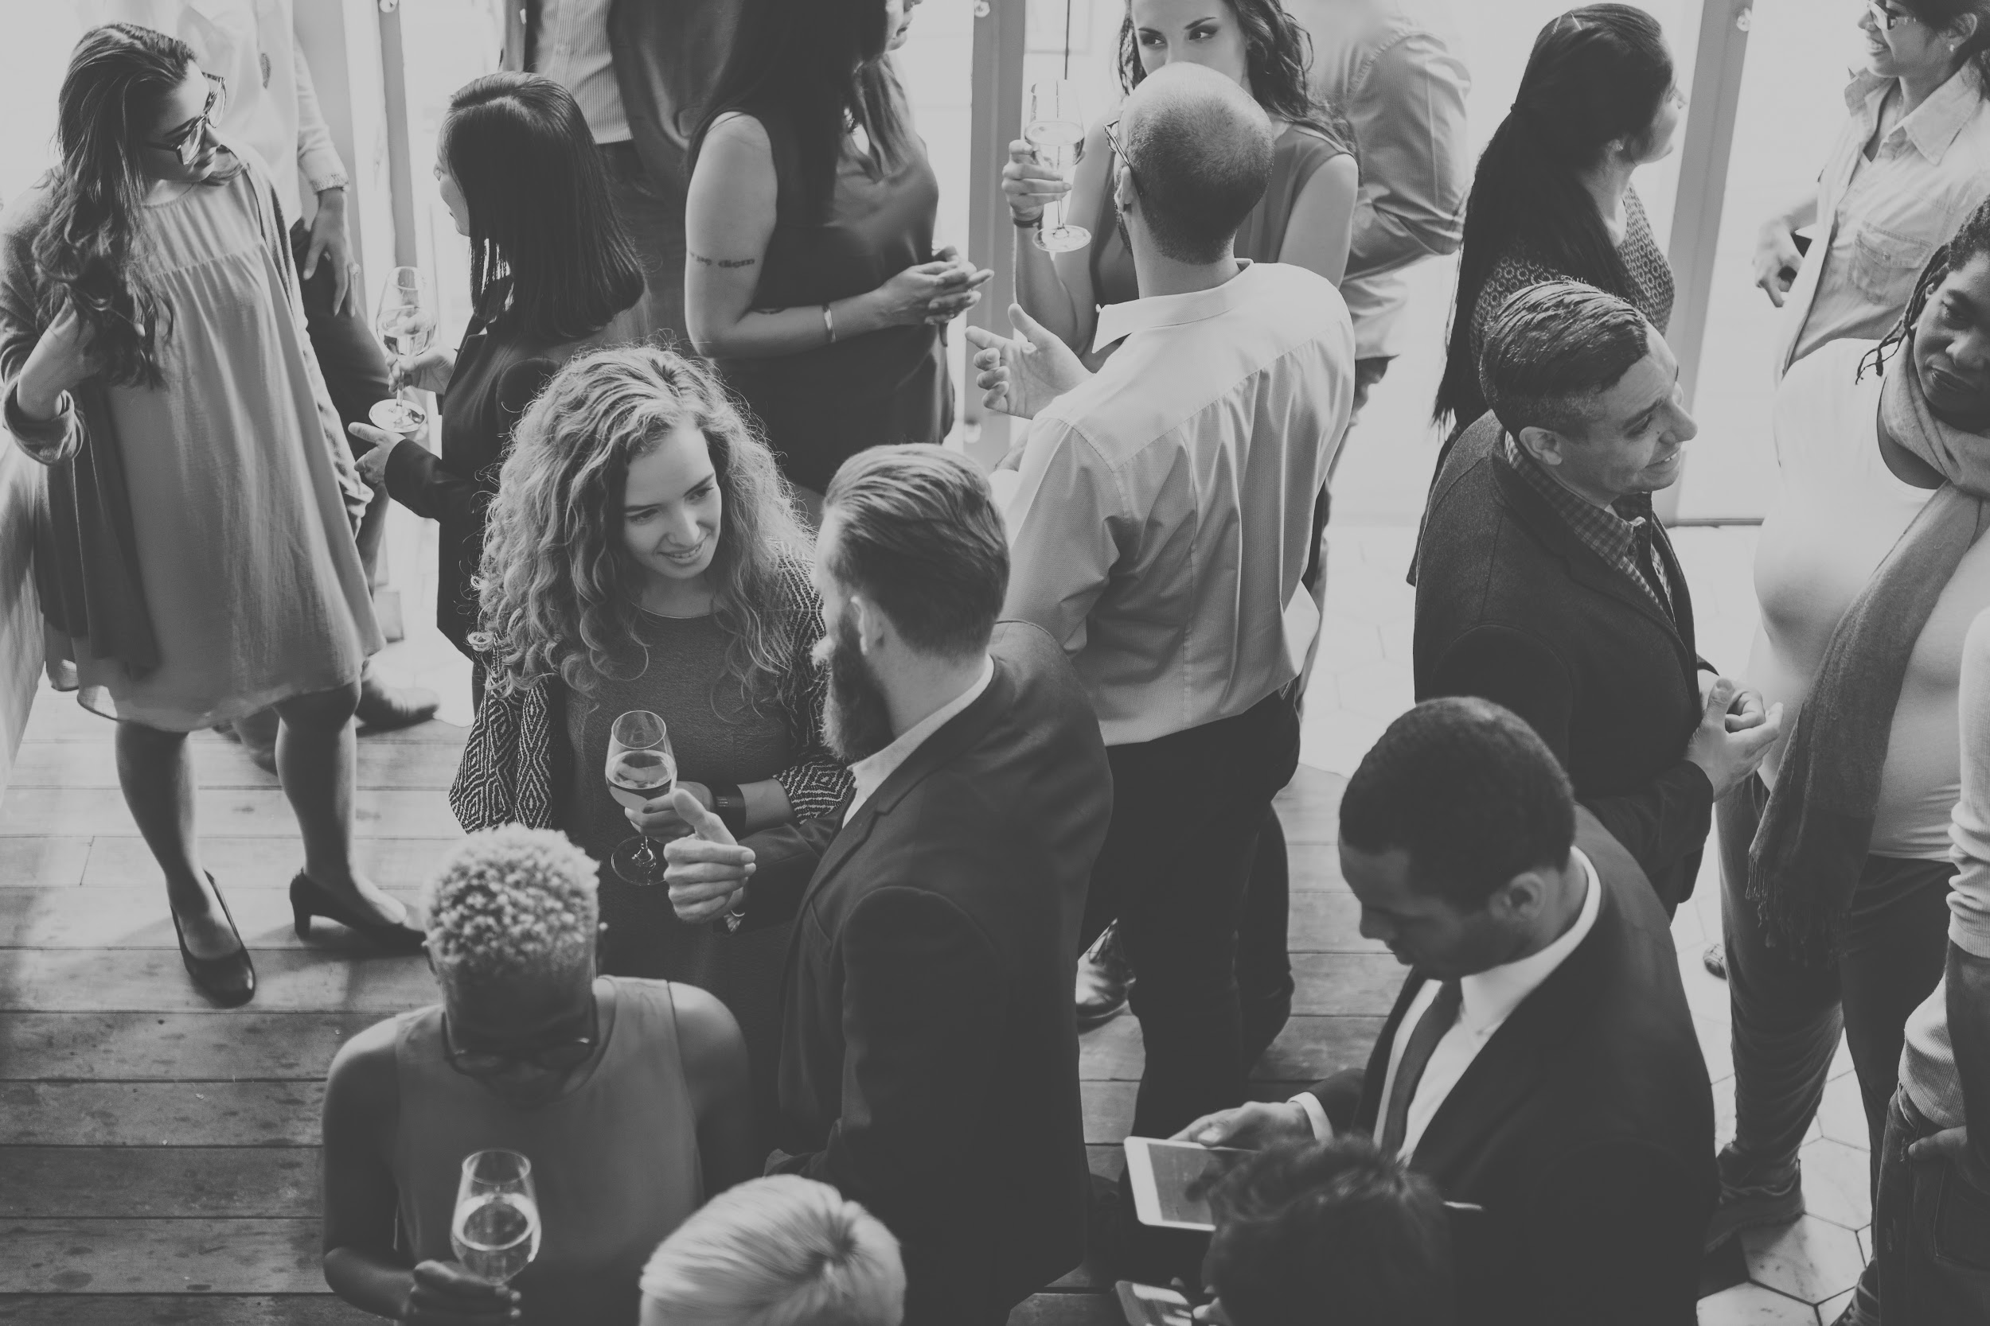

COCKTAIL STYLE
Notes:
No booking fees. (30-100pers.)
More glamorous, bubbles and finger food, very introductory, we will give a short speech and play a video or present before/after photos throughout the evening, discover smells and textures, book consultations
Demo tables / collections
It gets people talking and it develops relationships
6 to 9pm / attendance gift (sponsorships)
in or outside your clinic, you can coordinate with an ally and have it at their place ( restaurant, hotel, golf club…)

Slide 10
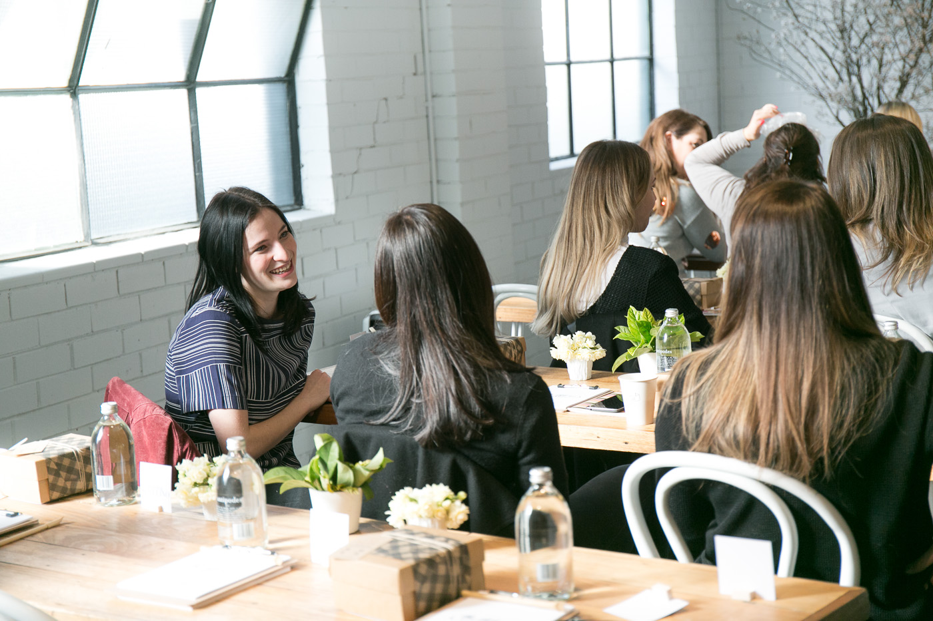
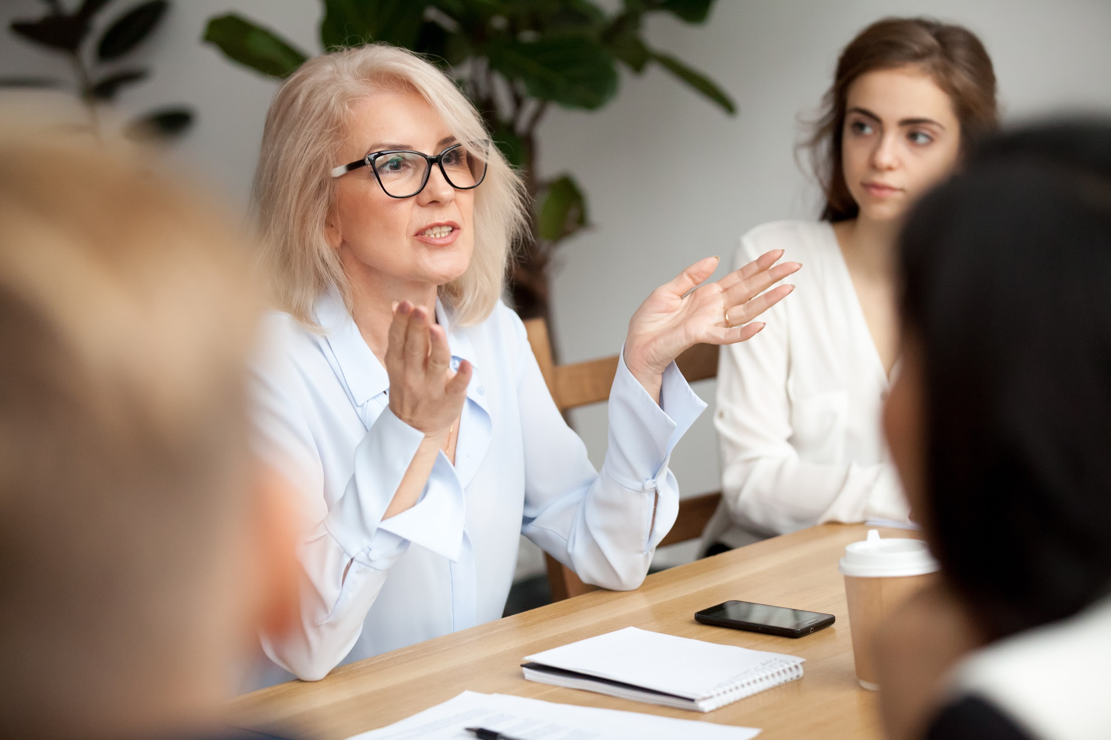
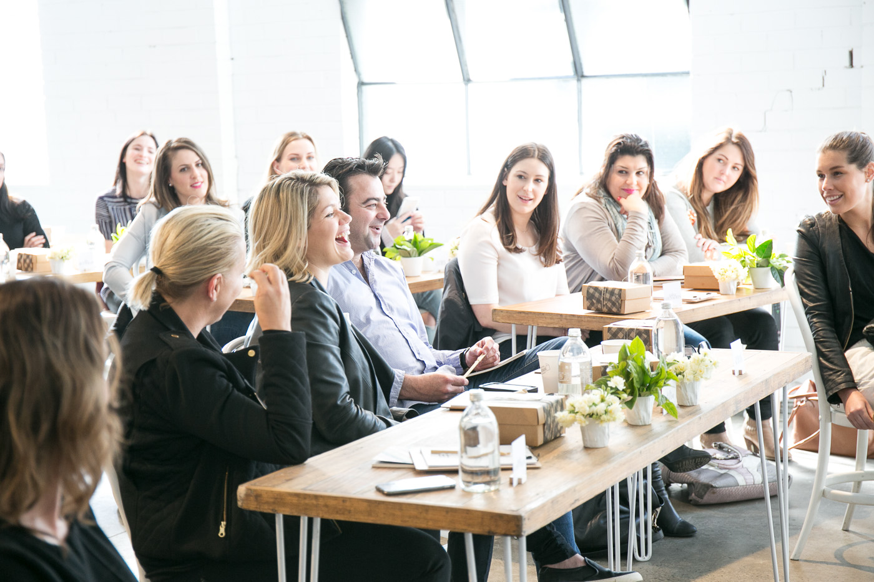
CONFERENCE STYLE
Notes:
25$-50$ credit upon purchase + prize draw 10-30 pers.
Educational +++ explain , questions, quiz, did you know?
With 1 on-site DEMO treatment and having the products tried on the hands (essential), group and private consultation afterwards
6 to 8 p.m. (2 hrs to checkout) )(attendance gift) (sponsorship) gift with purchase and draw

Slide 11
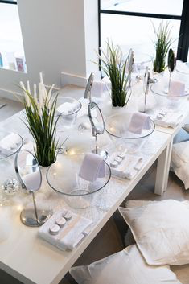
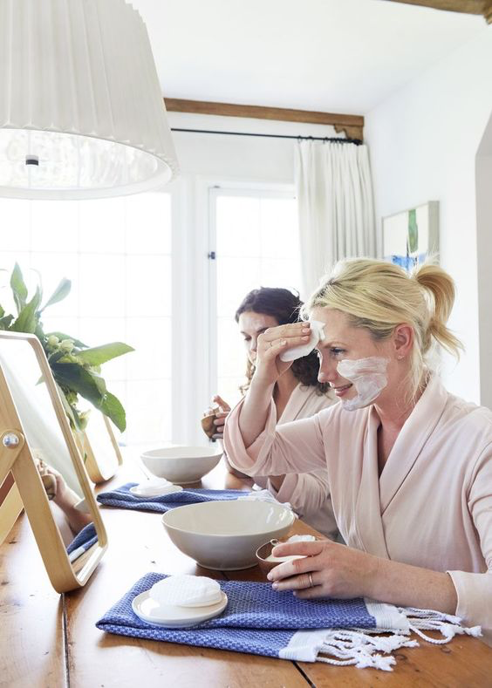
GROUP CARE
Notes:
150$ booking fee because self- applied Bio Care
Discovery event:
Everyone experiences a Bio Care treatment with a bowl of water and a mirror
(2 hrs+1 hr to checkout)
6 a.m. to 9 p.m. / attendance gift / sponsorship / gift with purchase / draw
Do consultations prior to event.

Slide 12

BACHELORETTE-STYLE
* GIRLS NIGHT
*OFFICE PARTY
Notes:
$$$$
Corporate evening (reward, week of recognition for assistants, secretaries, team building,etc.)
Bachelorette
Graduation ceremony
The girls like to meet and learn at the same time.
It's original!
You stand out!

Slide 13
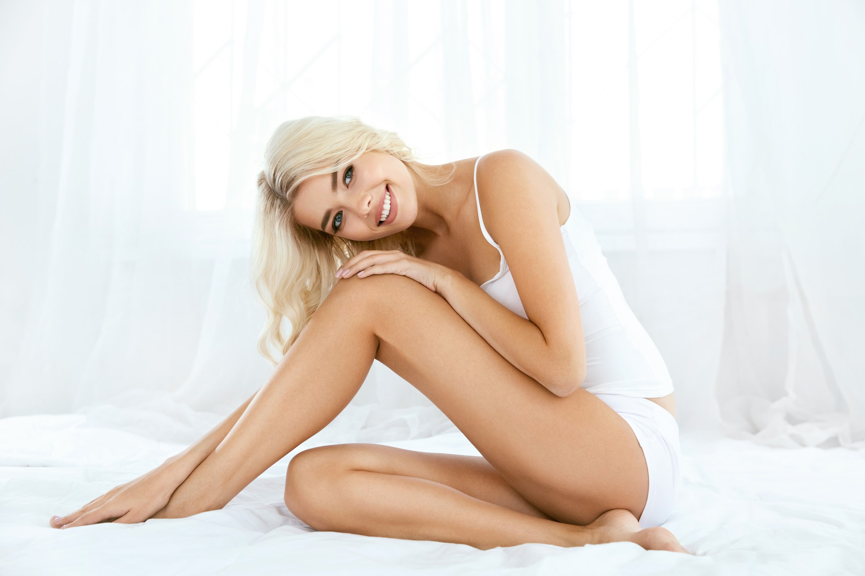
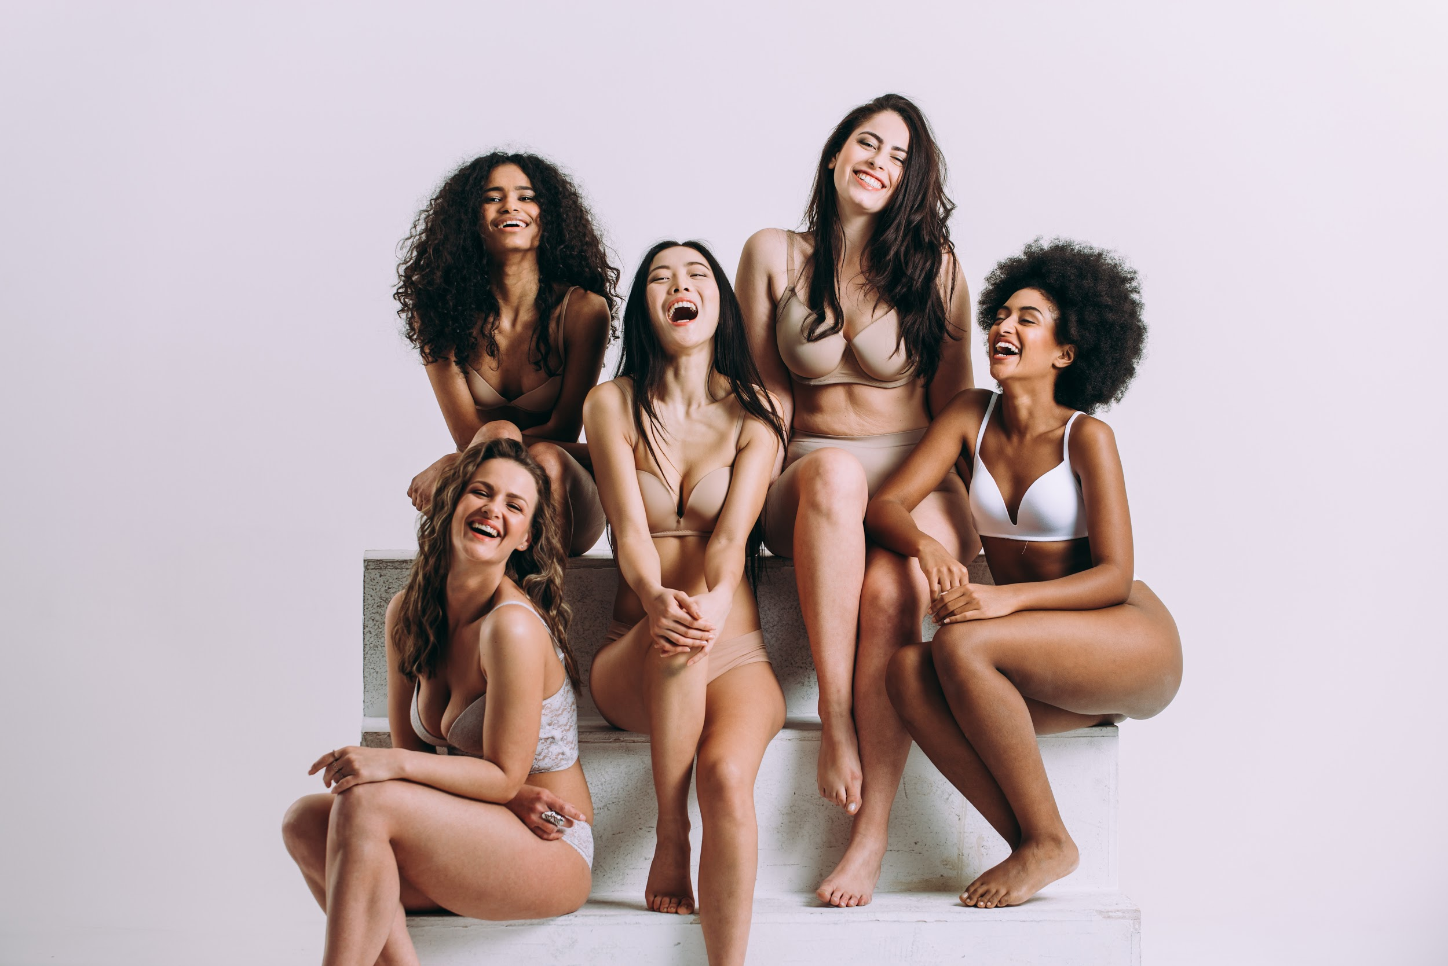
VIP FACE +
VIP BODY
Notes:
Booking fee = care pricing
Think of body VIPs too!
(water tub)
Foot care with the Dolce collection
calf care at the same time with the Silweta collection
Explain the protocol and show photos
It's fun and women really see the impact on their skin

Slide 14
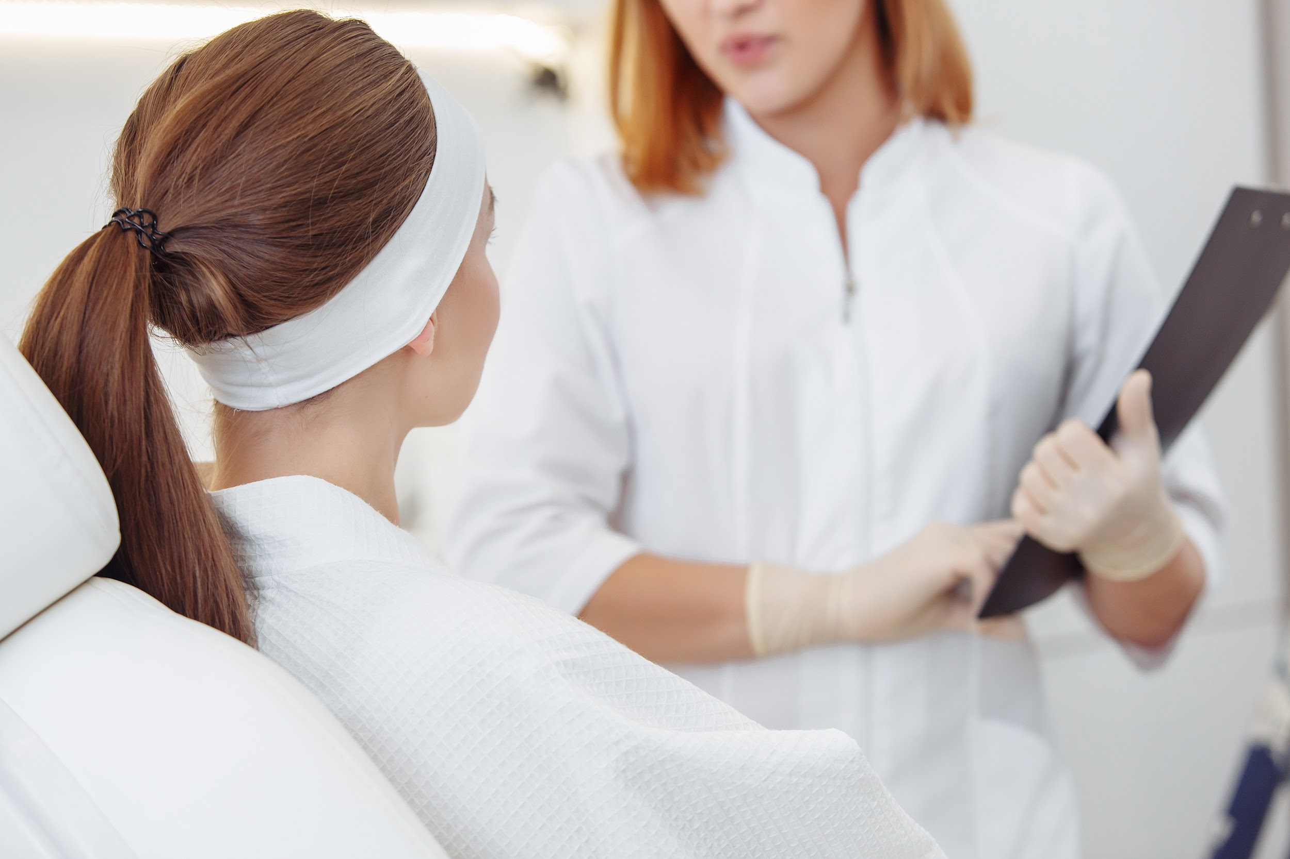
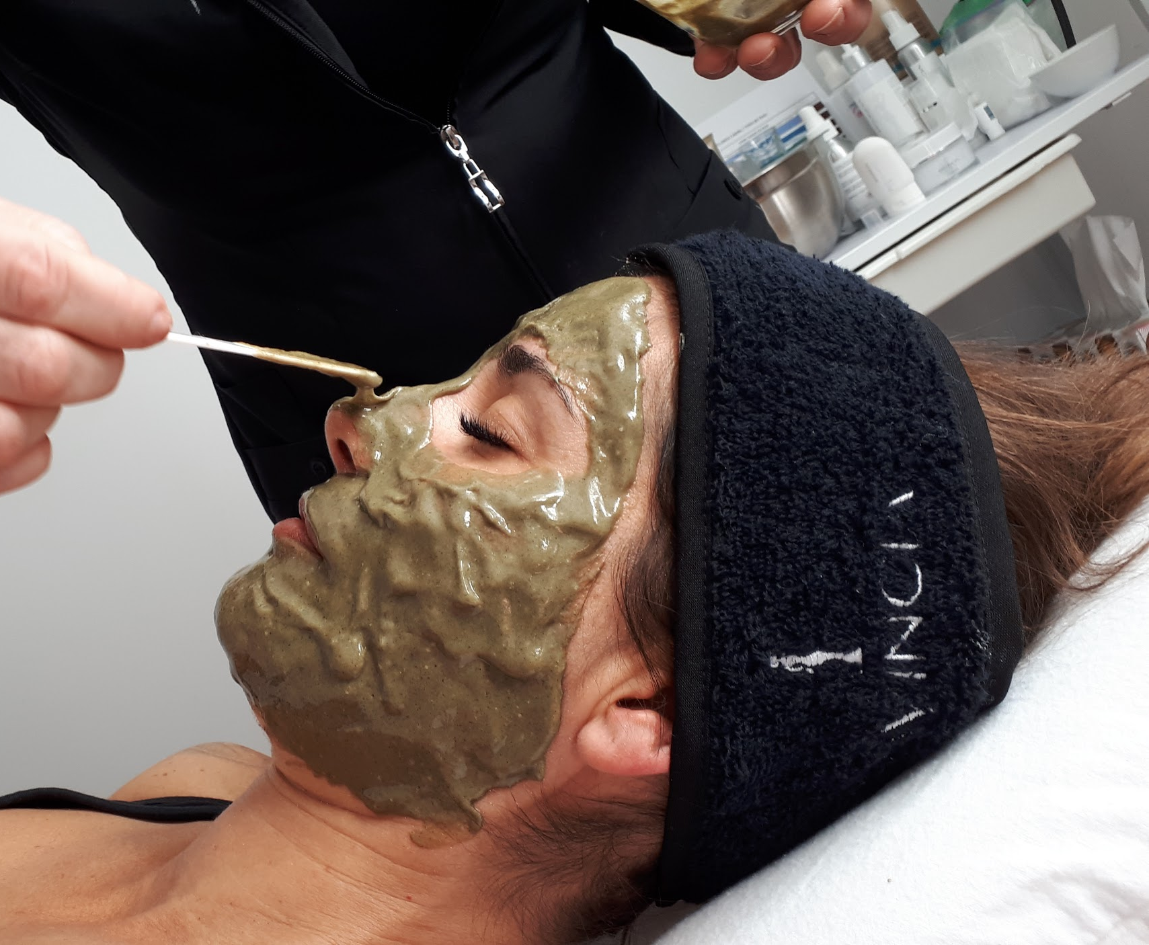
CARE DAY
Notes:
195$ fee to book Bio Care.
Consultation prior to VIP
You can put 2 people in the same cabin ( friends)
The customer experiences the treatment and can book a set of treatments afterwards to take advantage of the promotions ( 175$ if ++ treatments)
9 a.m. to 8 p.m./ attendance gift / draw + sponsorship + gift with purchase / draw

Slide 15
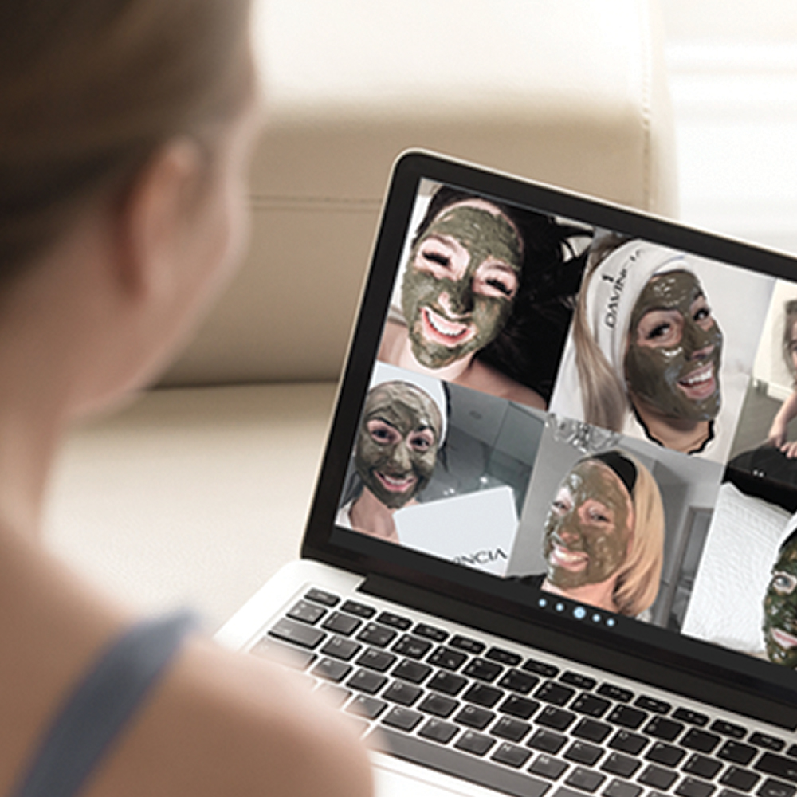
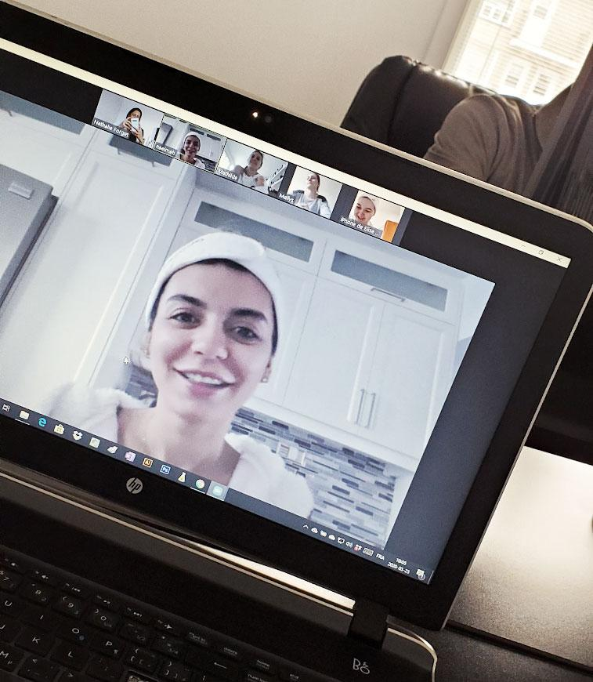
ON-LINE VIP

Slide 16
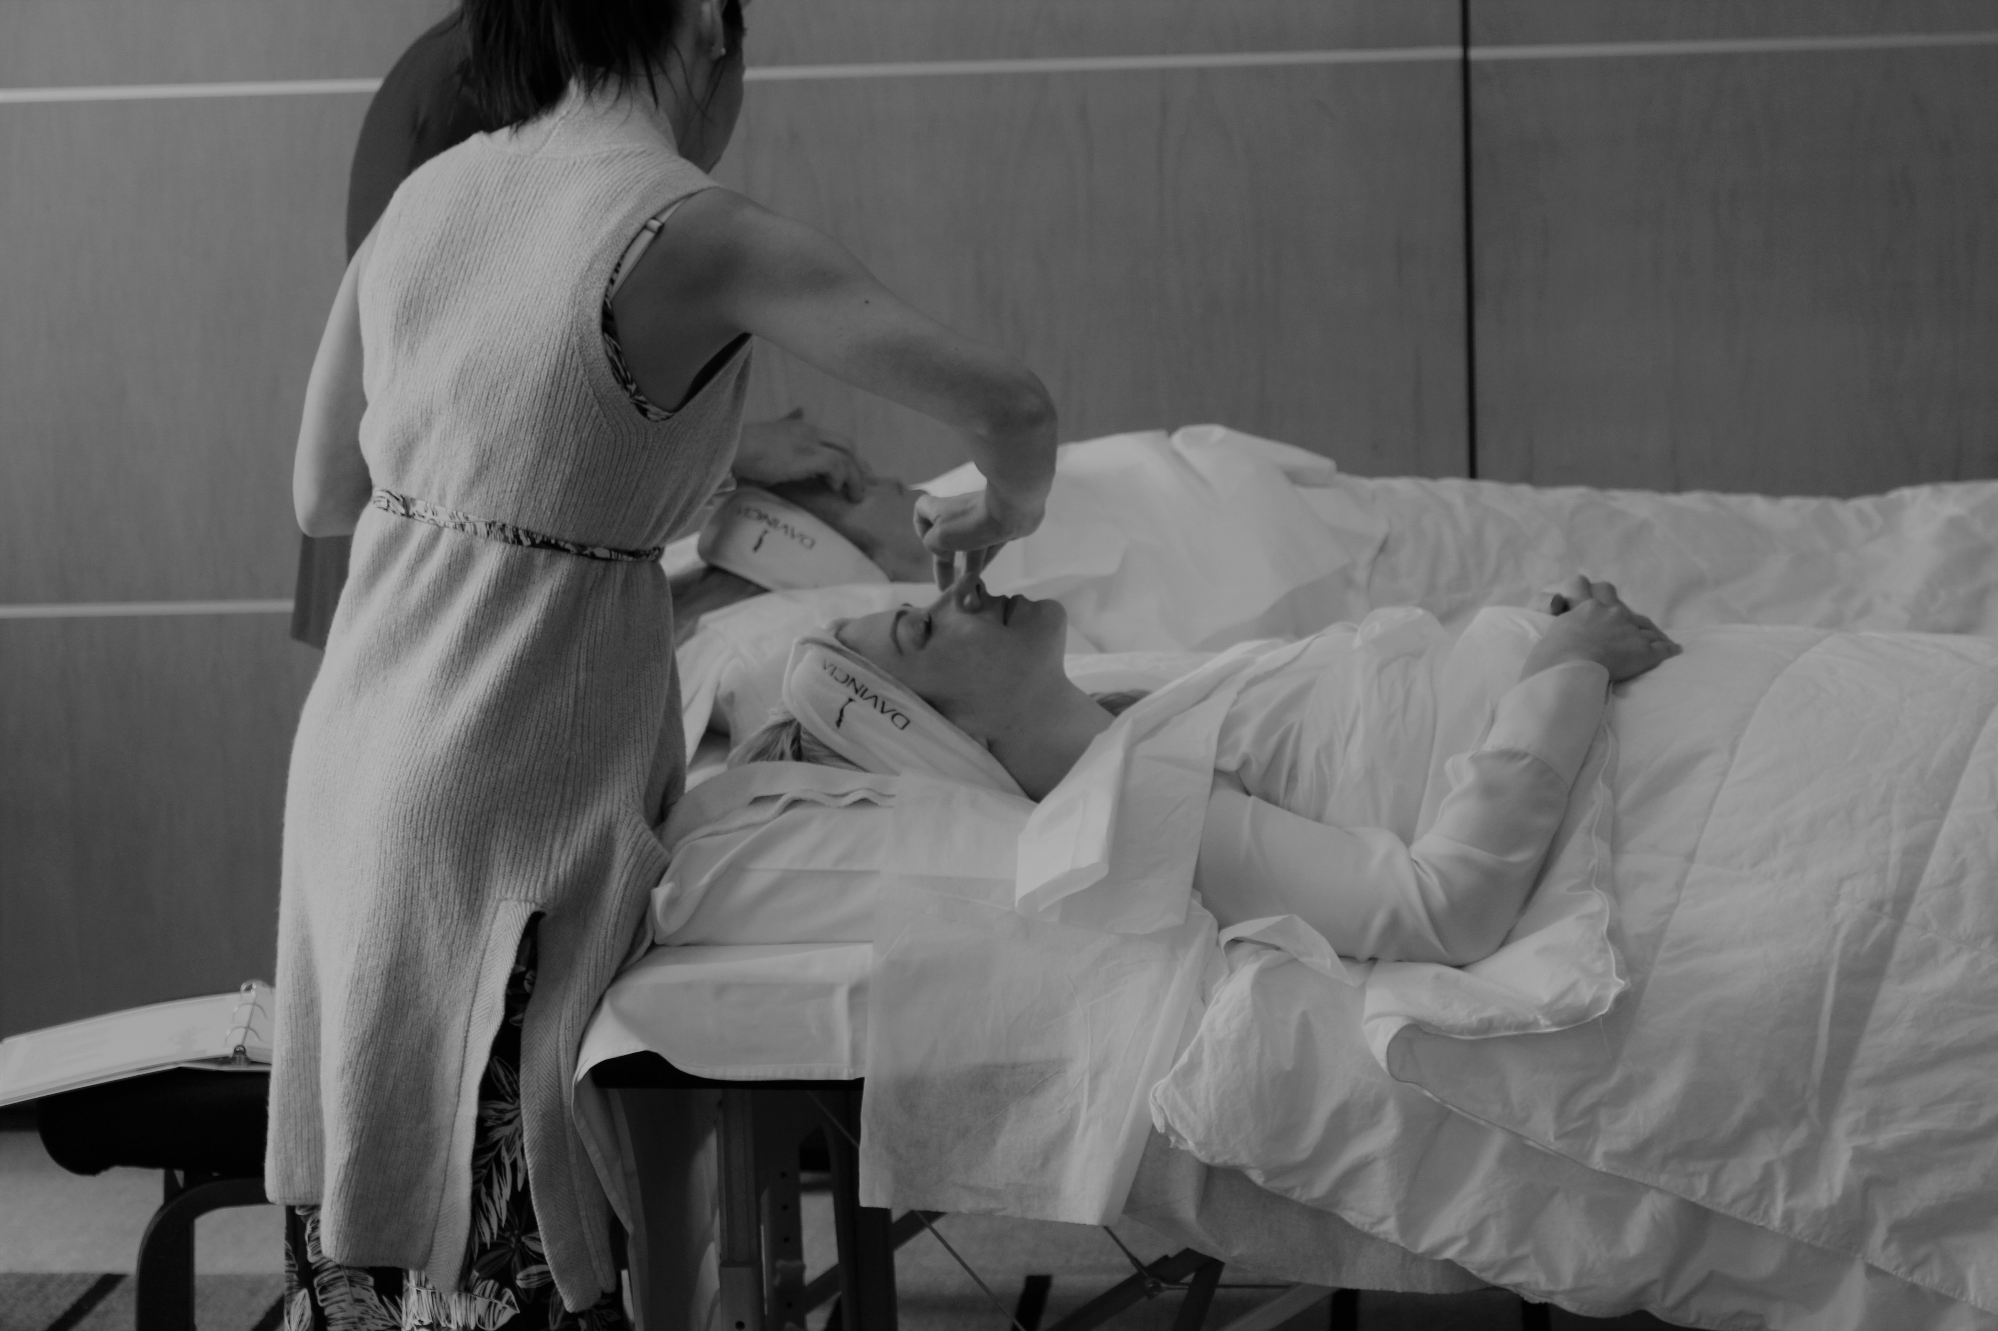
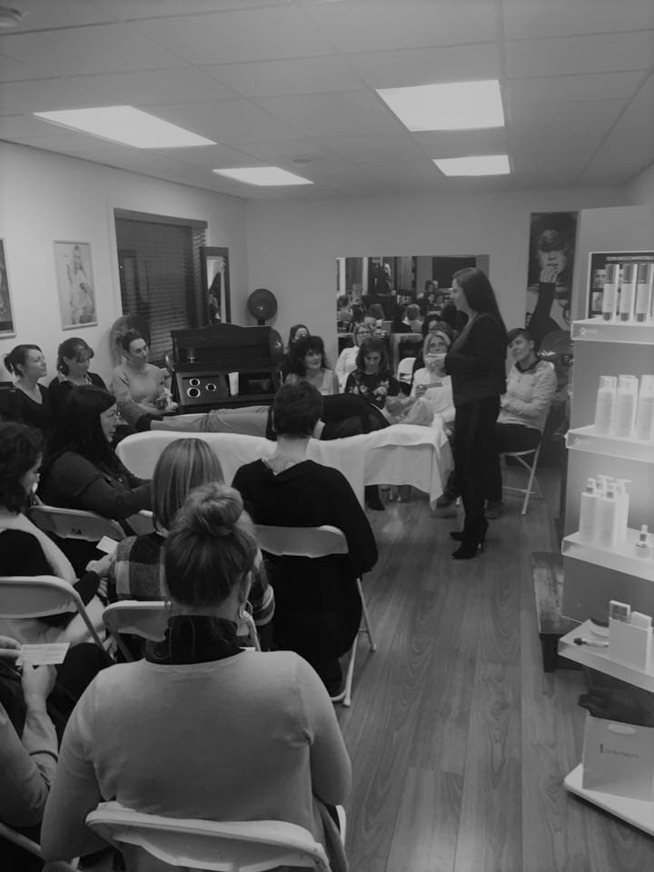
IN PERSON
VIP

Slide 17

WHEN ?
Choose your date a month in advance to advertise
A weeknight from Monday to Thursday
Plan to do 4 per year
VIP Bio Care. Oct / Dec / Feb / May
VIP Silweta and Dolce = beginning of February (before spring break and vacation down south and/or April (before summer)

Slide 18
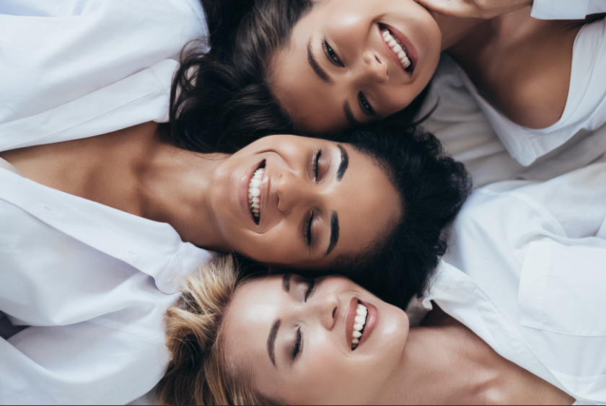
WHO?
High potential customers; be clear, display yourself, it's high-end!
Use your high-end sponsors and merchants
A customer who shows her satisfaction in front of your guests
Ask each good customer to bring a friend! *reference gift
Don't limit yourself to clients in your area; virtual clients can also benefit by FaceTime, Teams, Zoom...

Slide 19

HOW ?
-Have a display in your institute.
-Print cards to give to clients and merchants/sponsors.
-Send emails.
-Make phone calls.
-Create an event on FB.
-Invite people via FB and IG, Messenger, do a vocal story it’s -more personalized.
-Share on Instagram with countdown.
-Reward clients who bring friends or family, ask for referrals!
-To get 1 participant, it's almost 100 invitations, so have confidence!
-You build momentum on the first VIP and then you surf the wave for the others with the same clients who invite friends

Slide 20
Online VIP INVITATION TEXT from Davincia
Hi xx,
Here's an opportunity to take some time just for YOU and experience the Biocompatible® Care, a face mask that is alive, like your skin, and that will vitalize it by optimizing its skin flora.
I know your skin will love these 100% natural and effective products from Quebec.
I am inviting you to the Davincia virtual party!
On the menu:
-Conference on XXXXXXXXXXX
-Attendance prizes
-Gifts
On xxxx at xx hr by ( Zoom, Teams)
2 simple steps:
1- Purchase this wonderful professional treatment to do it with us by replying to this message or by contacting me at (area)-xxx-xxxx
2- Register to book your place (limited places)
Here is the link to register ↓
I look forward to seeing you there!

Slide 21
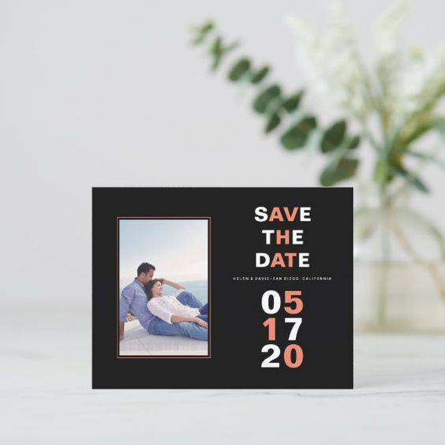



CREATING AN
EVENT
Choose an audience
Choose a budget
Invite people to the event
(when they click interested, their friends see it too!)
Post montages and before/after pictures, post regularly with a countdown
Confirm attendance!

Slide 22
Get Ready!
-Visit the portal to have access to beautiful images.
-Order your supply of products for sales and gifts with purchase.
-The MODEL; a skin that needs love and wants to buy.
* (take her pictures before and plan the before/after photo software to save time)
-Plan who does what (employees, friends, spouse)
-Someone to take pictures (it's time to build a bank of beautiful -pictures of you giving a care, of your institute, of your products and show that there are many people!
-Plan who will close the sales!
-Prepare your recommendation sheets by client with basic care products.
-Prepare your invoices ( if paper)
-Prepare your price lists.
-Master the subject, more knowledge = more confidence = more sales!
-Add some scent!

Slide 23
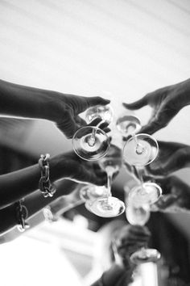

WHAT?
Fun / Experience / Teaching / Gifts / Sales

Slide 24

SPONSORSHIPS
Women's clothing store
Natural products store
Hairdressers
Manicurists
Massage therapists
Spa
Yoga center
Gym
Restaurant
Catering
Florists

Slide 25
OVER THE COURSE OF
THE EVENING
Get them to participate and ask questions!

Slide 26
ACNÉ | HYPERSÉCRÉTION DE SÉBUM | POINTS NOIRS | PORES DILATÉS
ROSACÉ | ACNÉ - ROSACÉ | TACHES BRUNES & MELASMA | RIDES
PEAU RELÂCHÉE | CERNES | POCHES | CICATRICE
LAUGHTER & PLEASURE FOR THE SENSES
Make people laugh; laughter increases information retention
Make people touch, feel; use the senses!
Run through the order of products used for the Care by giving key words
How and when to use them (group pre-consultation)

Slide 27
ACNÉ | HYPERSÉCRÉTION DE SÉBUM | POINTS NOIRS | PORES DILATÉS
ROSACÉ | ACNÉ - ROSACÉ | TACHES BRUNES & MELASMA | RIDES
PEAU RELÂCHÉE | CERNES | POCHES | CICATRICE
SAVE TIME
Be strategic ;-)
-Review the recommendation for the basic products
-Give examples, share tips for usage
-Have a satisfied customer testify
-Quickly present the other Davincia collections
-Present your gifts with purchase in the presence of everyone

Slide 28
ACNÉ | HYPERSÉCRÉTION DE SÉBUM | POINTS NOIRS | PORES DILATÉS
ROSACÉ | ACNÉ - ROSACÉ | TACHES BRUNES & MELASMA | RIDES
PEAU RELÂCHÉE | CERNES | POCHES | CICATRICE
TAKE PICTURES/VIDEOS
Do a live on your social networks
Be dynamic; action calls to action

Slide 29
ACNÉ | HYPERSÉCRÉTION DE SÉBUM | POINTS NOIRS | PORES DILATÉS
ROSACÉ | ACNÉ - ROSACÉ | TACHES BRUNES & MELASMA | RIDES
PEAU RELÂCHÉE | CERNES | POCHES | CICATRICE
LAUNCH THE DATE FOR THE NEXT
ALWAYS PREPARE FOR THE NEXT ONE
Ask your clients to invite friends to share the good news!

Slide 30
THE FOLLOWING DAY
Have your live draw for yesterday's attendees
Give them an opportunity to come back to your institute to get their gift
Make those who couldn't make it eager to book the next date
Share the date of the next VIP for registration then!!!

Slide 31

Notes:
»I never lose, I either win or learn. » Nelson Mandela

