Slide 1


Slide 2
RE-LAUNCHING YOUR BUSINESS THANKS TO VIPs

Slide 3



A CHANCE TO MAKE SOME NOISE
BUILDING RELATIONSHIPS & LOYALTY
ATTRACT NEW CUSTOMERS

Slide 4



CREATE mini REPRESENTATIVES
PROMOTE YOUR PRODUCTS/SERVICES
CALL TO ACTION

Slide 5

SET YOUR GOAL
I sell 10 cures ⇀ I sell $15k
Highest VIP to date $54k/day to 3 estheticians

Slide 6

TYPES OF EVENING EVENTS

Slide 7
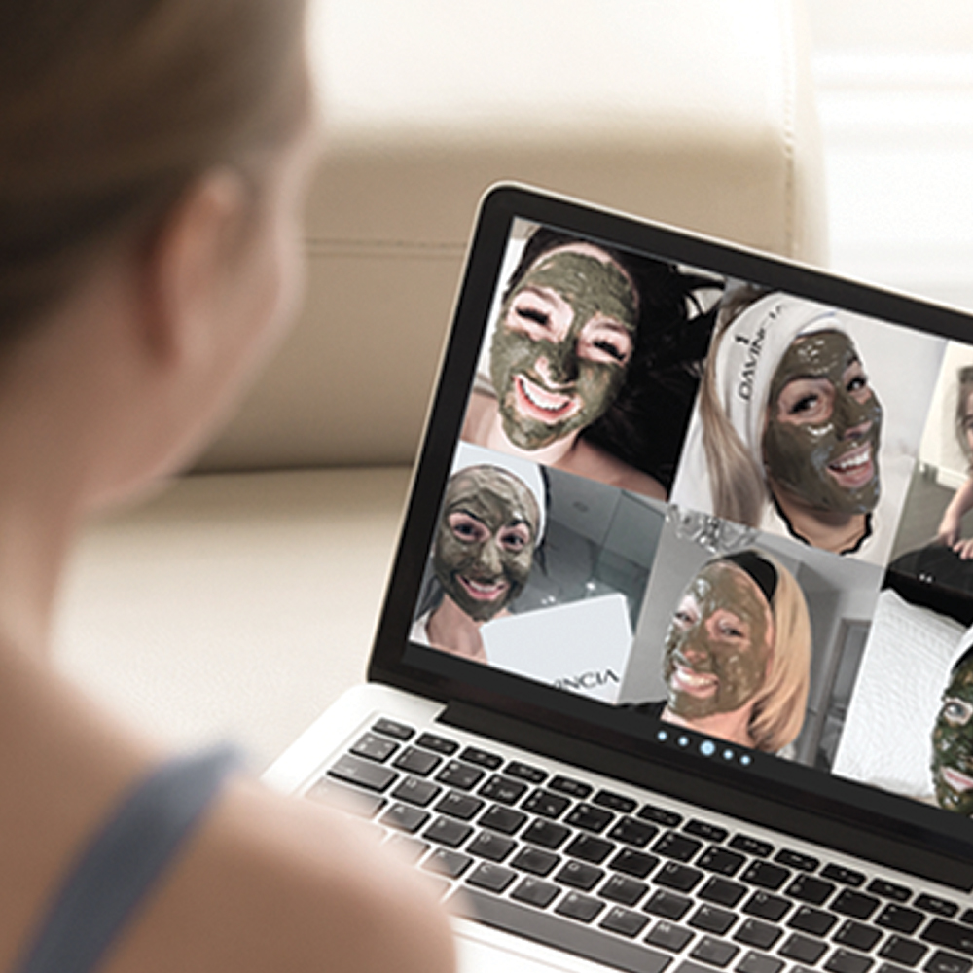
ONLINE VIP

Slide 8
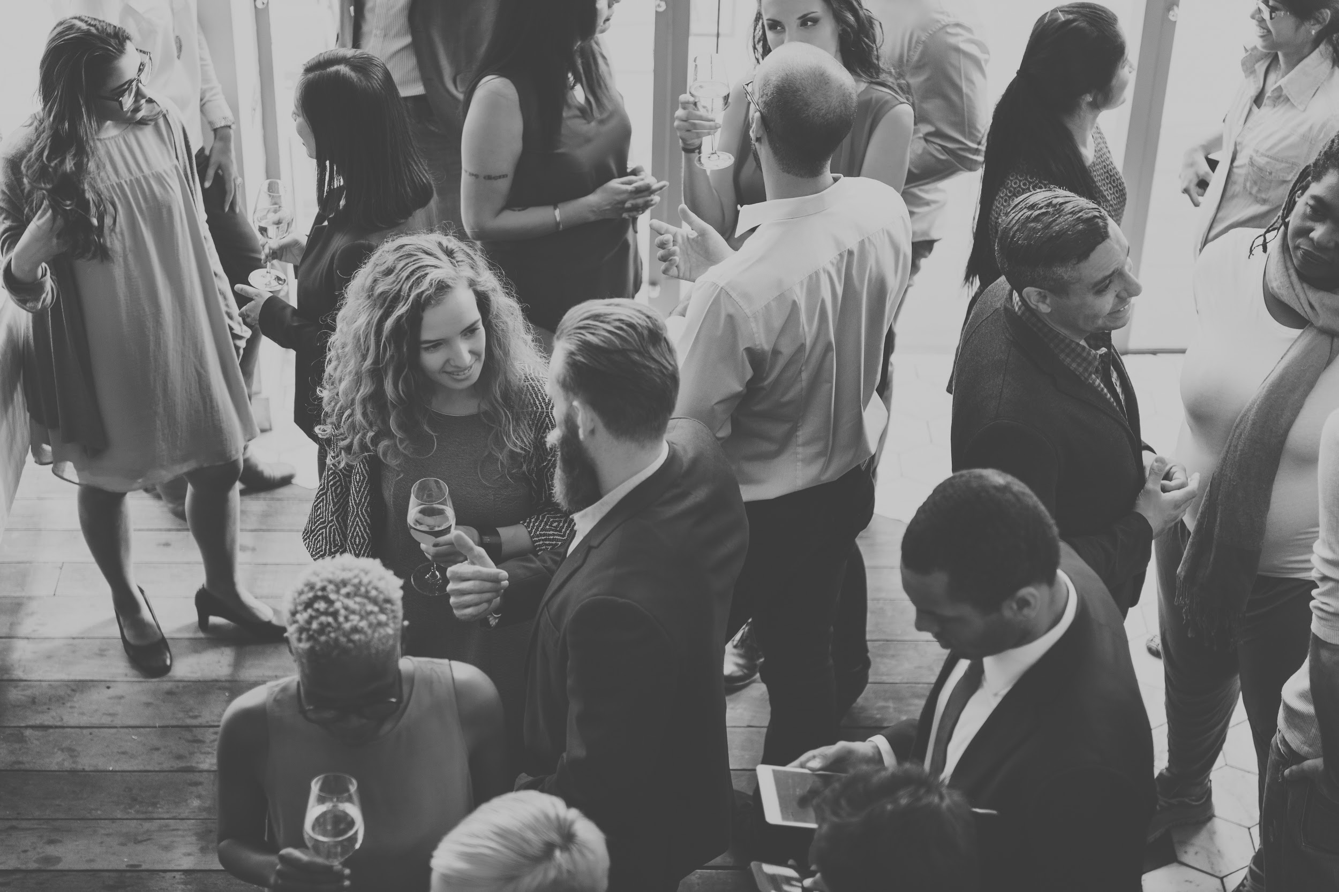
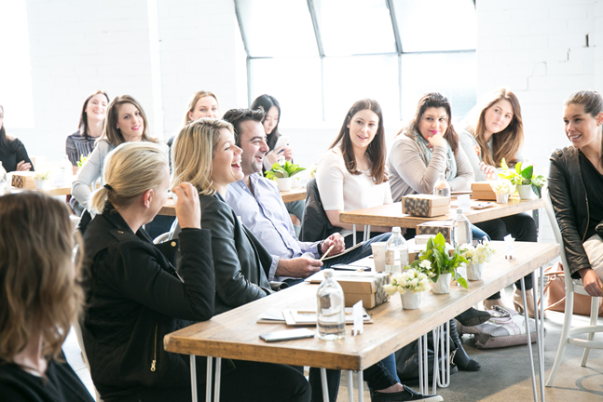
COCKTAIL STYLE
CONFERENCE STYLE

Slide 9
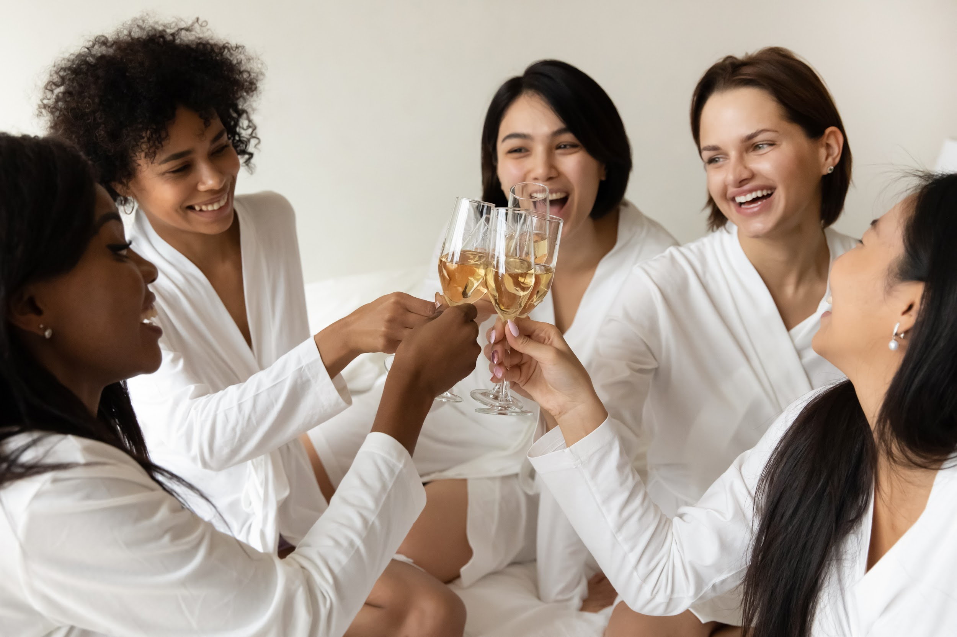
BACHELORETTE STYLE*
GIRLS' PARTY*
OFFICE PARTY *

Slide 10
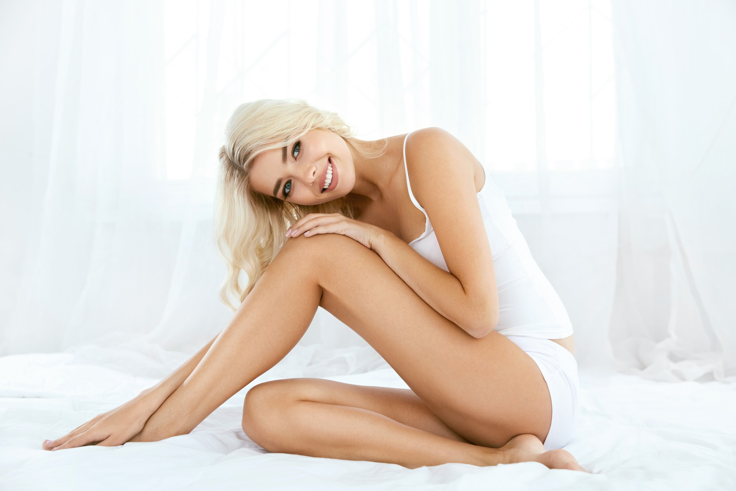
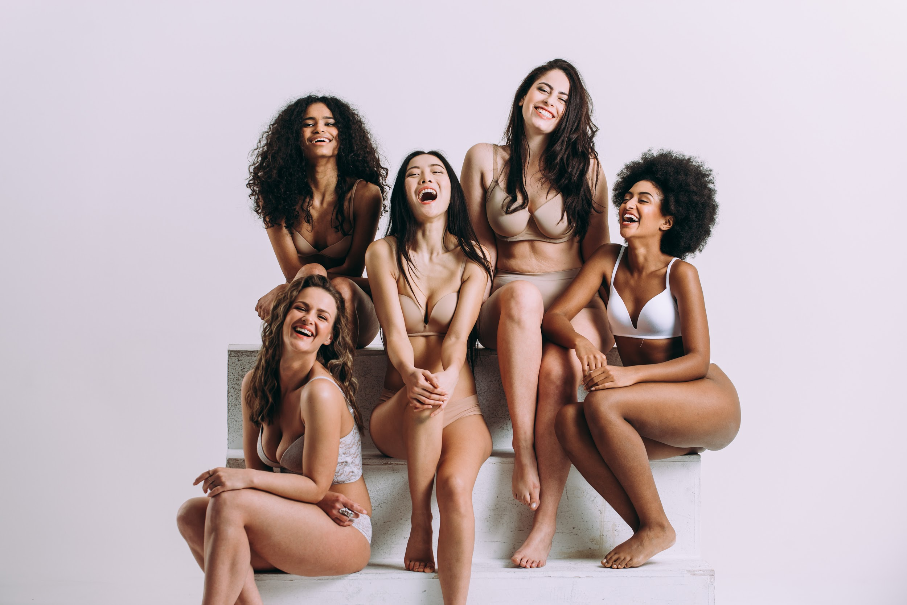
FACE
BODY
SUNSCREEN

Slide 11
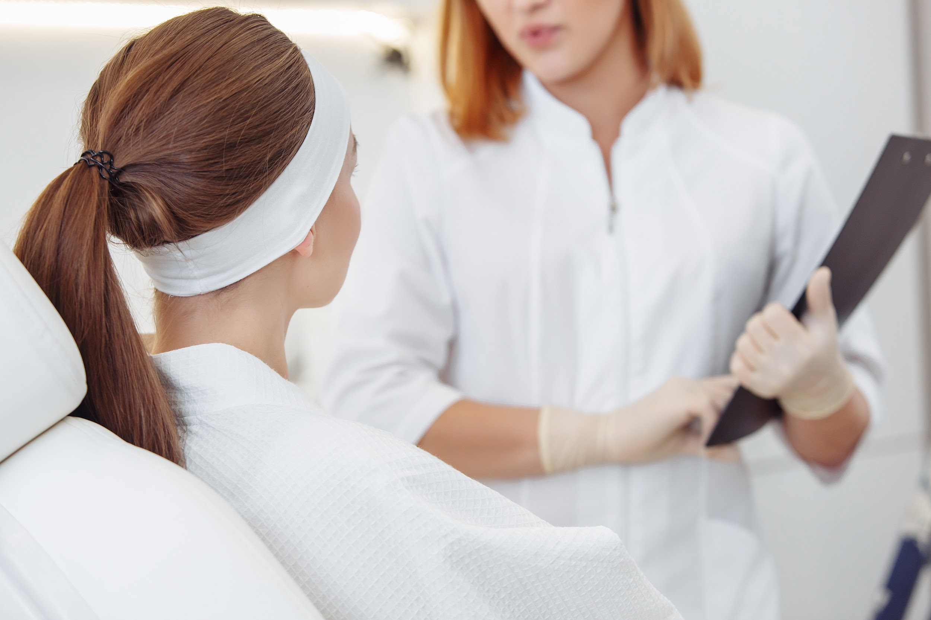
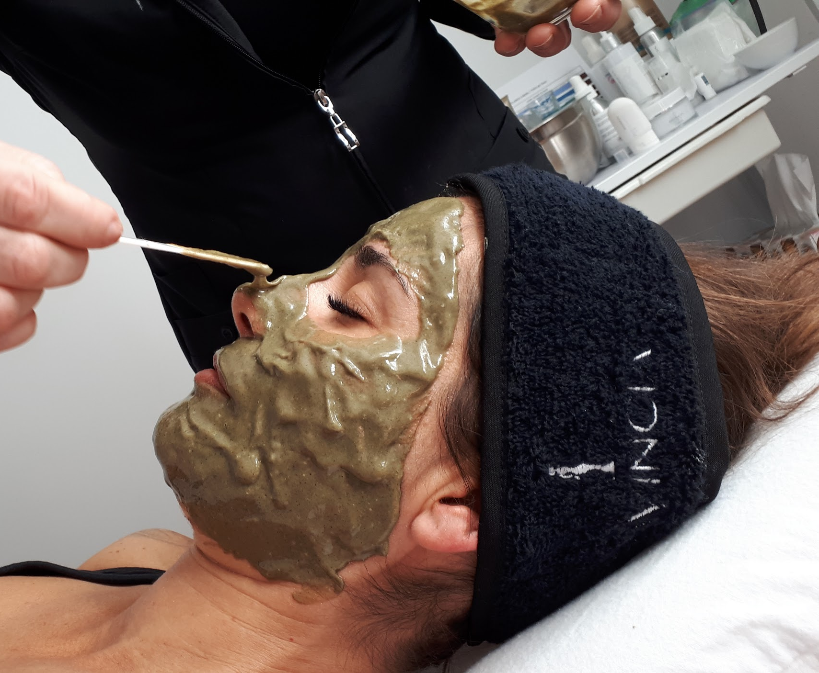
*DAY OF CARE

Slide 12
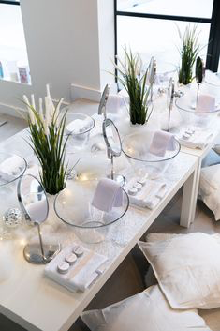
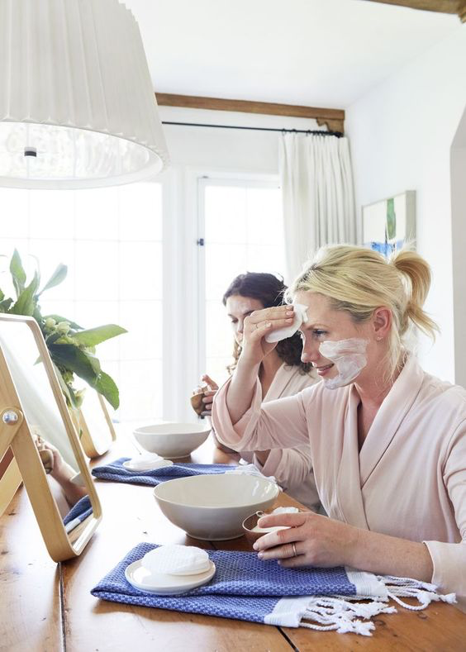
*GROUP
TREATMENT

Slide 13
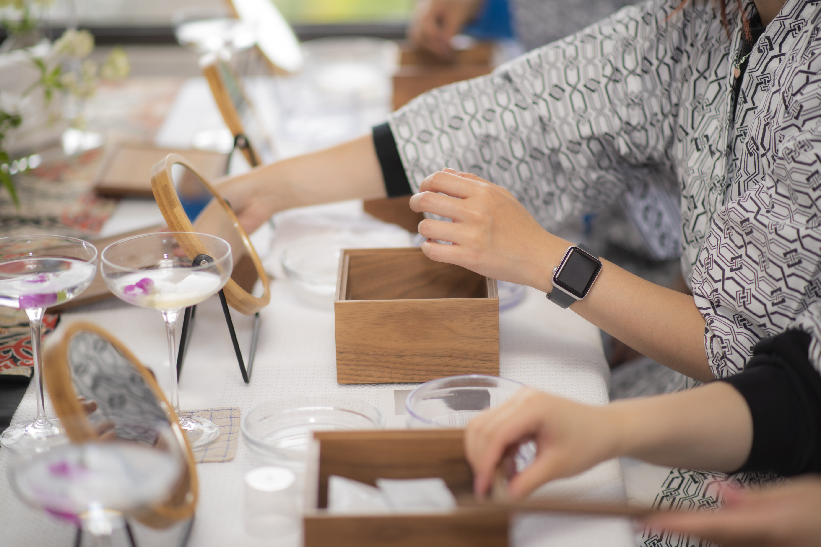
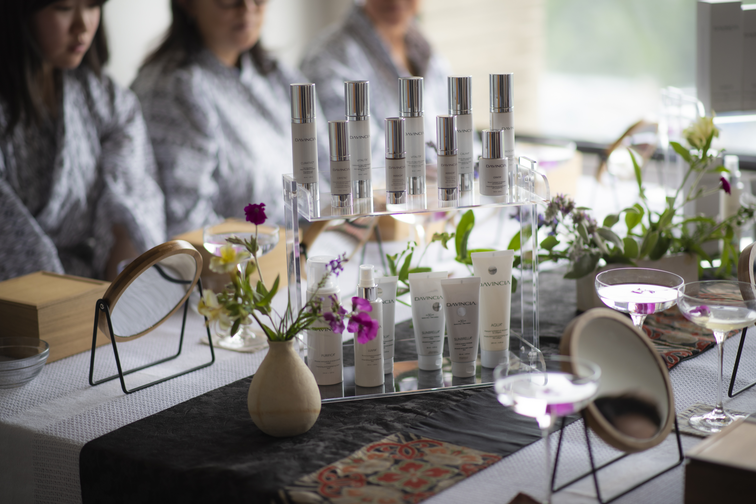
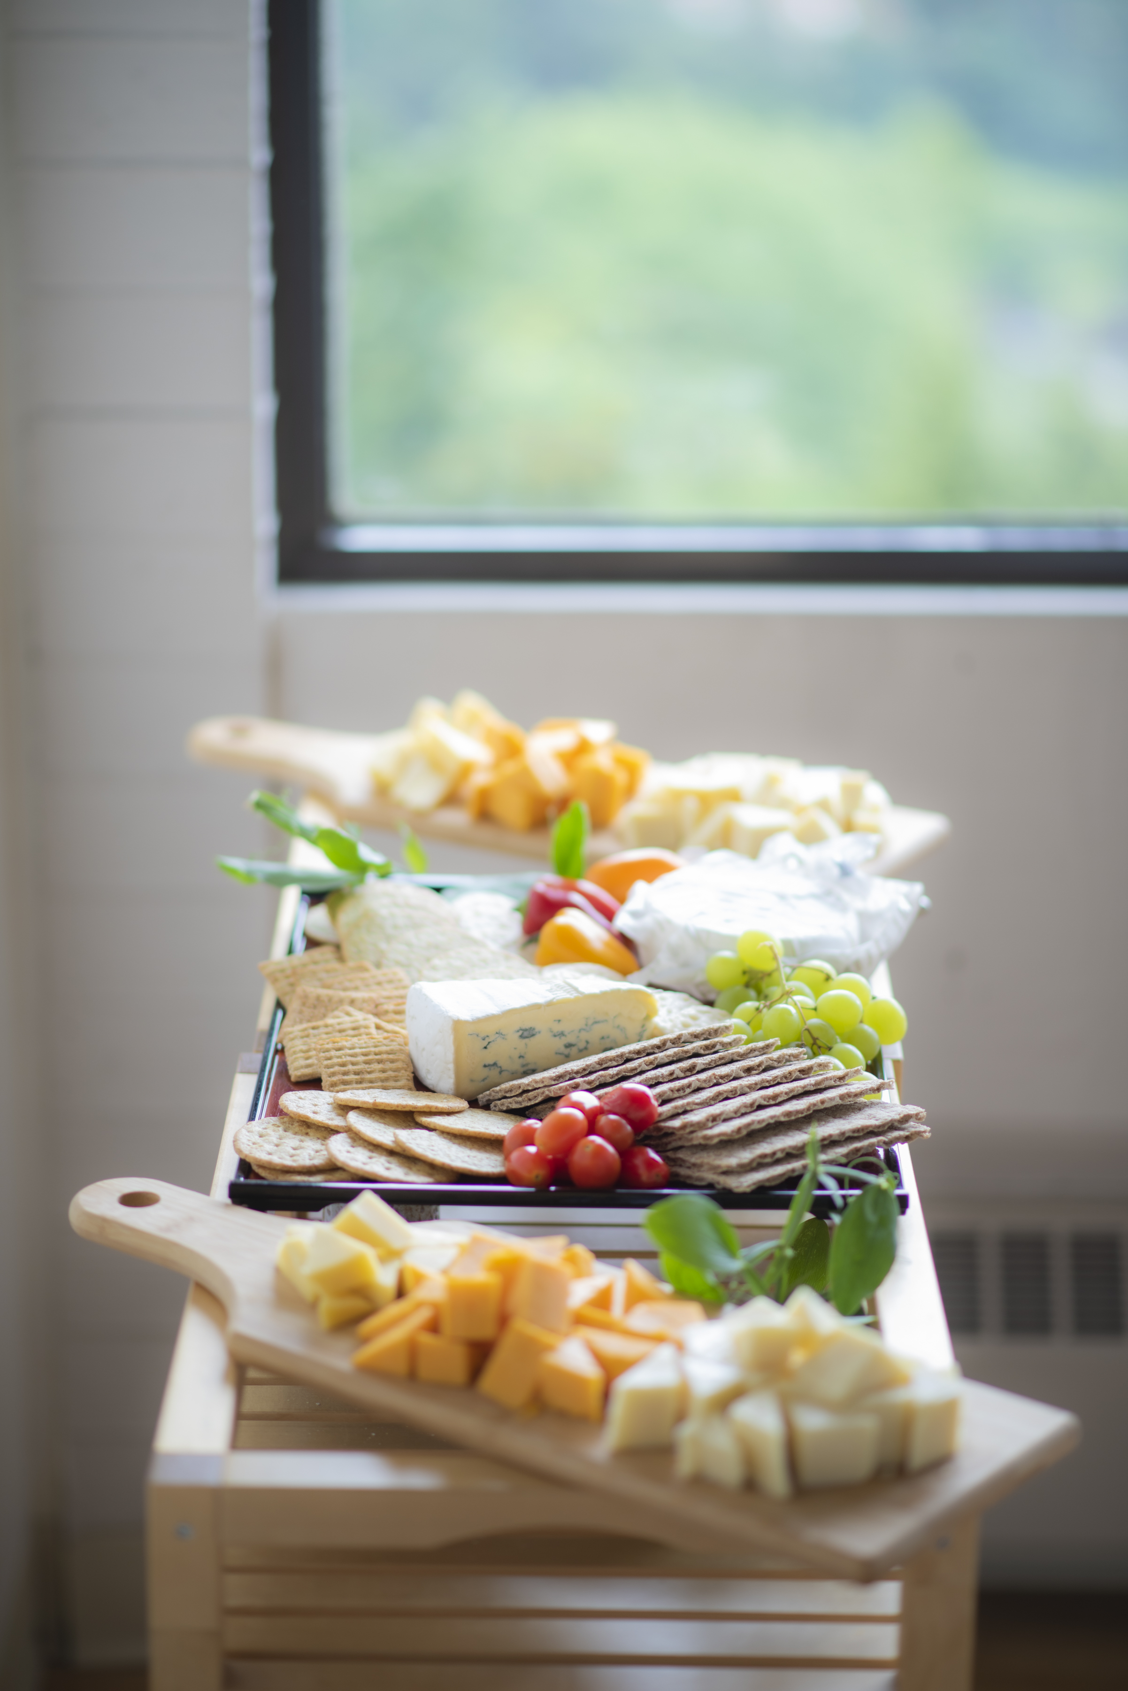
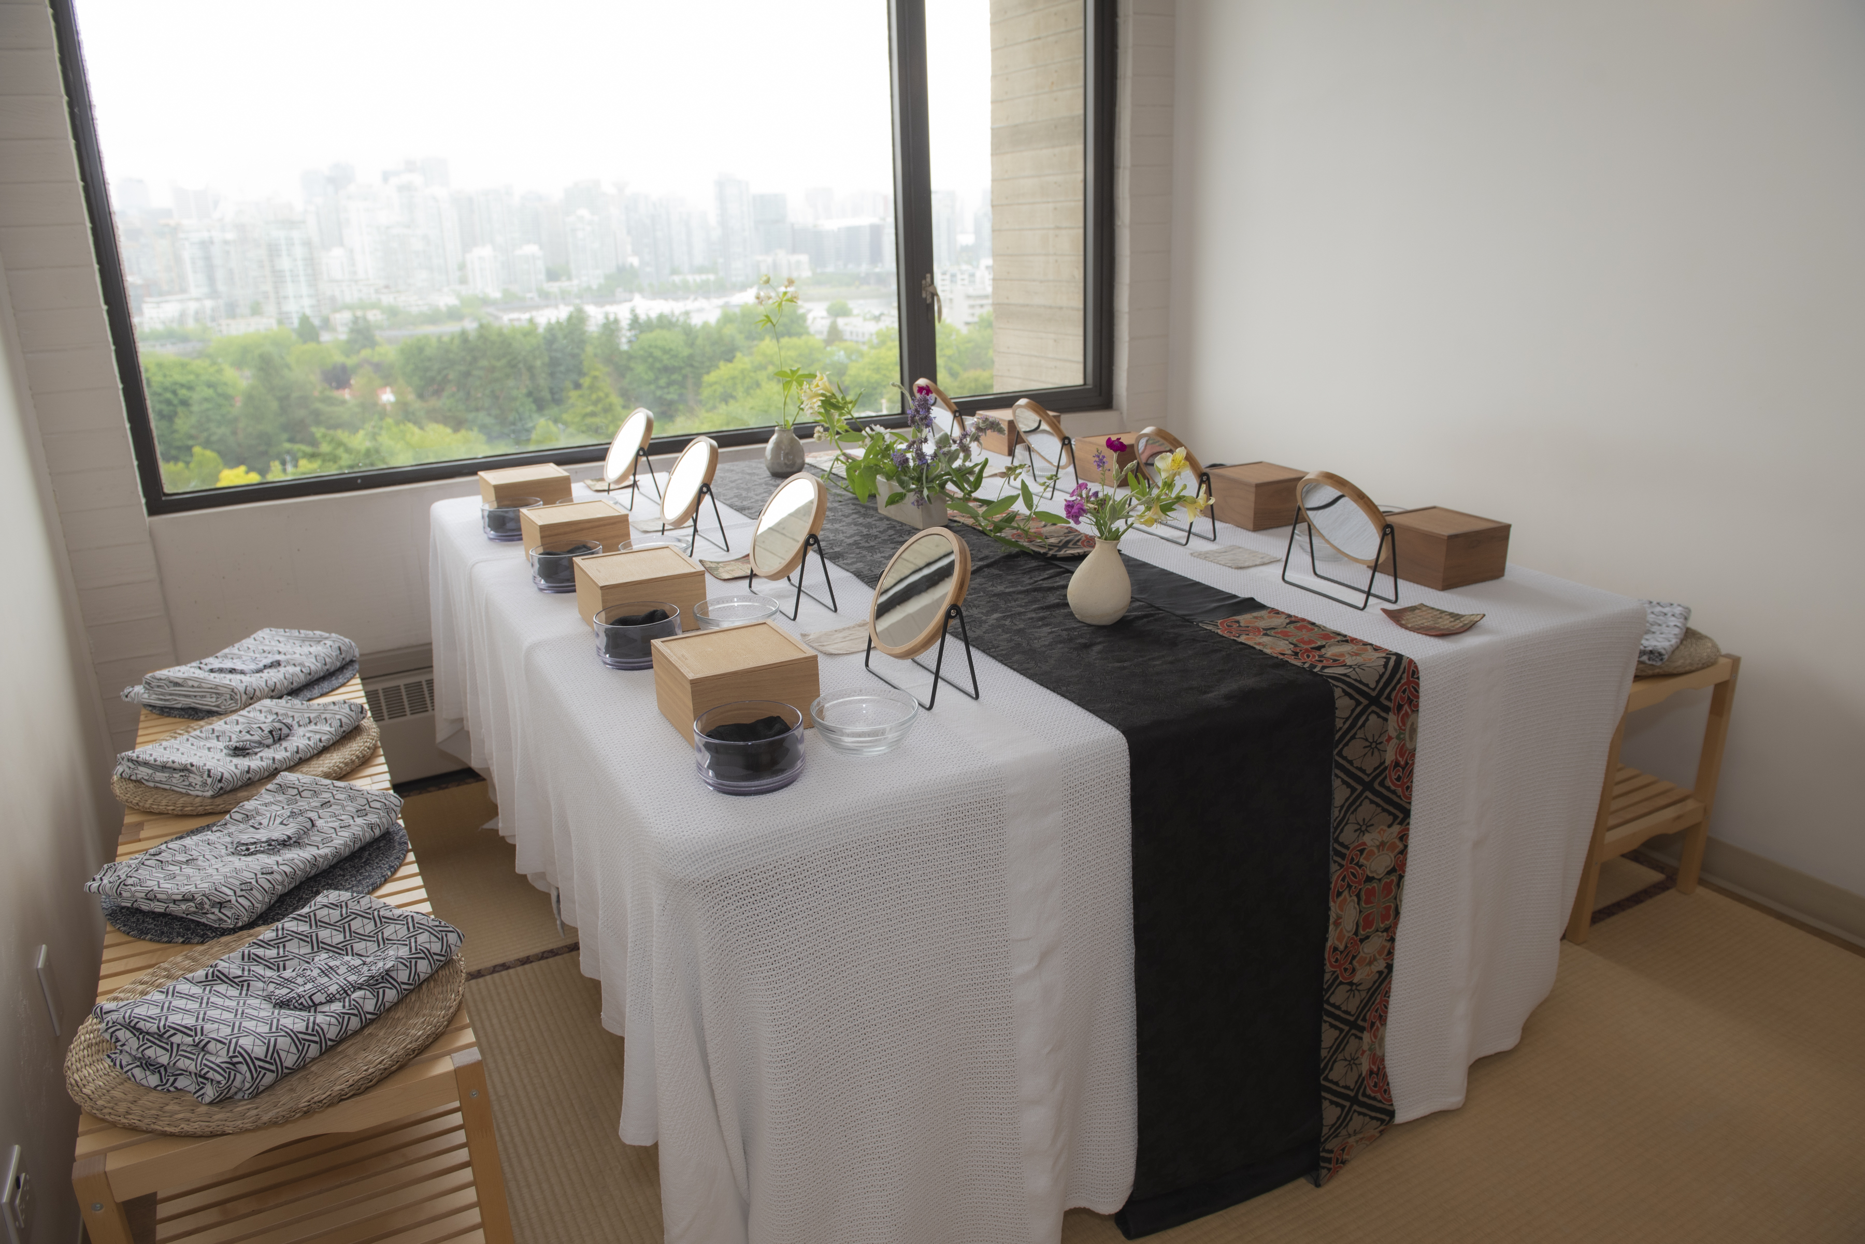
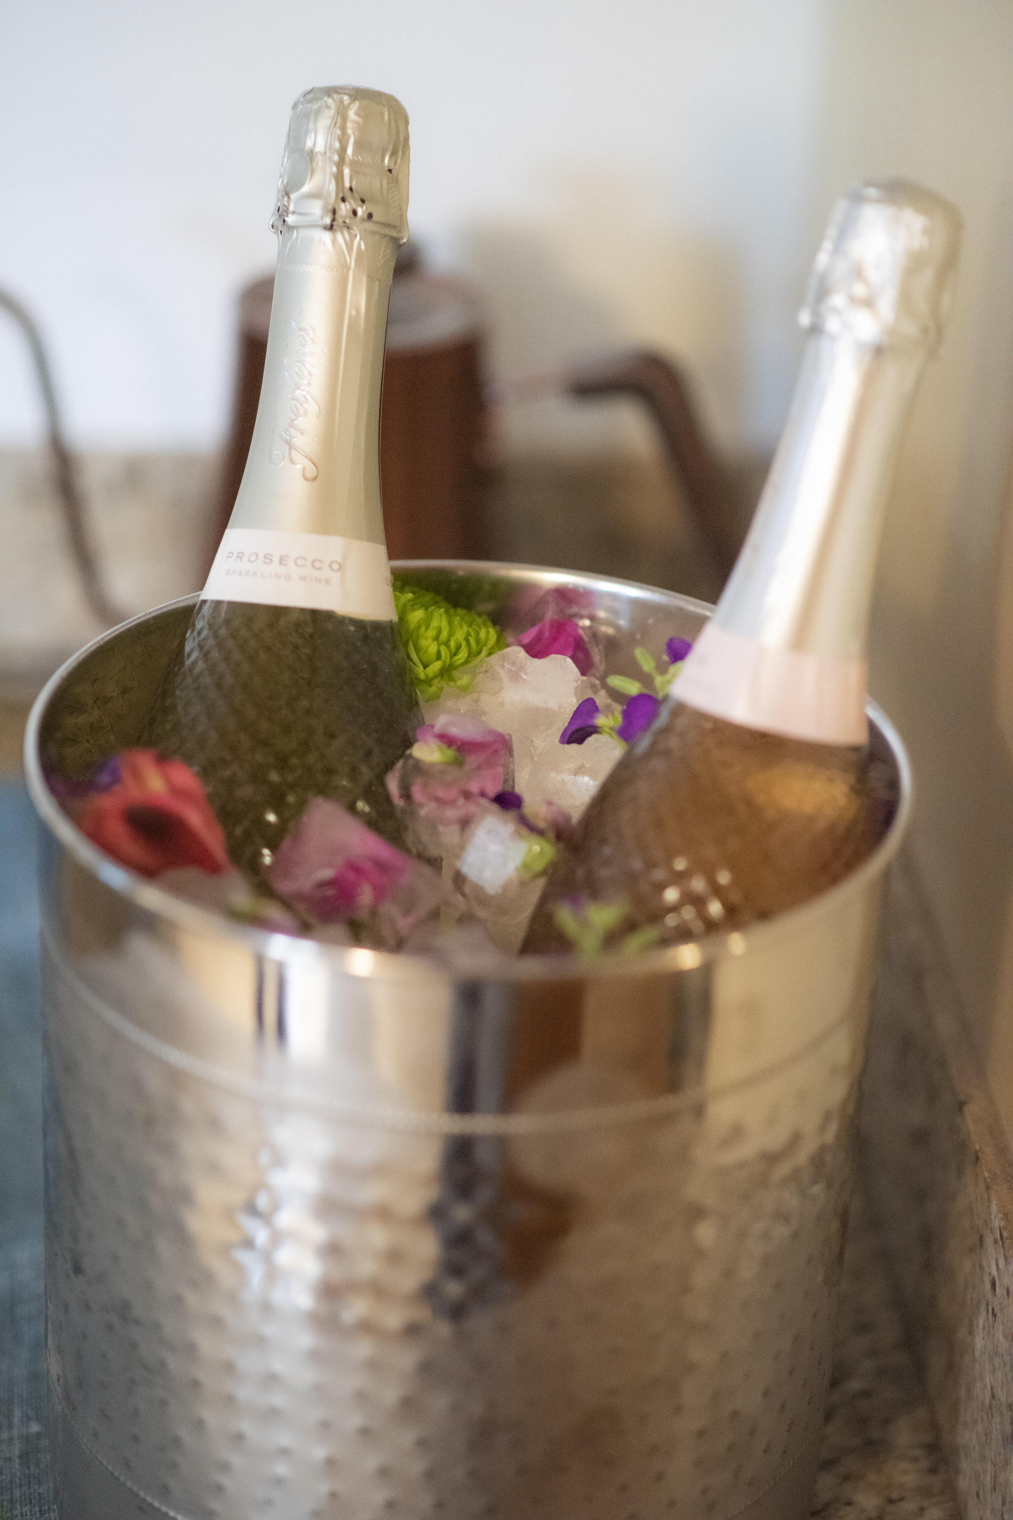

Slide 14

WHEN ?
Plan to do 4 / year
Sept
Nov (before black Friday)
Feb
May (before mother's day)

Slide 15
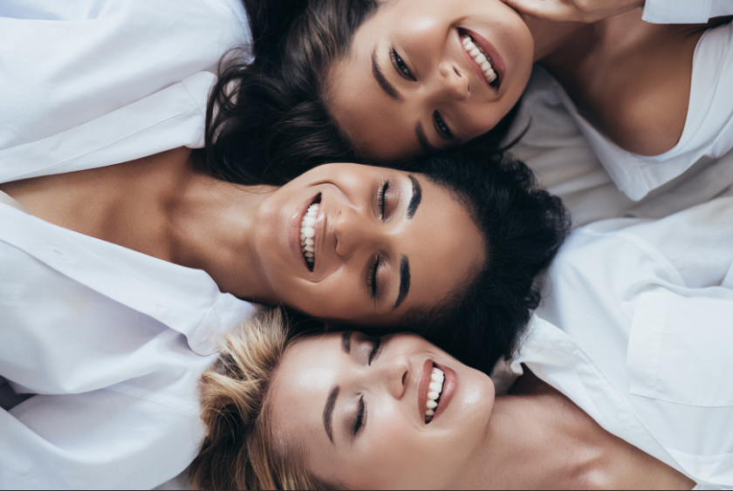
WHO ?
High-end customers, be clear !
Neighboring business owners

Slide 16
WHAT ?
Care: 1 every 2 hours or Auto Care
Presence gifts: Ex. Pro Bio mask ($50 value), Davincia headband
Drawing gifts: Lifting tools, Silweta, Purliv, Dolce
Gifts with purchase: Sun powder, body sun, Mirada, Sunbrella balm
Presentation of the Founder and her story (Make ads with her photo)
Products to be tried on site: Breath freshener, Dolce exfoliant and cream, body sunscreen
Be strategic with your giveaways to boost sales
Charge to reserve places (people must pay in advance)

Slide 17

HOW ?
Phone calls (no. 1 very important)
Messenger messages
E-mail
Poster in your institute
Cards to give to every customers
Live on your page with a testimonial from a happy customer
Create an FB event Invite
Countdown on IG
Stimulate referrals (referral gifts $50 credit per referral)
To get 1 guest, that's almost 100 invitations, so be brave!
Plan the date of the next event
Make a list of your potential customers for follow-up calls and keep it for the 3 other VIP
Book Consultation prior to analyse the skin and fill the papers

Slide 18
SCHEDULE
For group self-care
Organize tables of 6-8-10 people
08:30 am Brunch
09:00 am Start of treatment
10:30 am Sales
11:00 am Brunch dinner
11:30 am Care begins
13:00 pm Sales
13:30 pm Cocktail
14:00 pm Start of treatment
3:30 pm Sales
4:00 pm Cocktail
4:30 pm Start of treatment
6:00 pm Sales
6:30 pm Cocktail
7:00 pm Care begins
8:30 pm Sales

Slide 19
INVITATION TEXT to Davincia’s online VIP
Hello xx,
Here's an opportunity to take some time just for YOU and experience the unique Biocompatible Care ®. This treatment is a female Canadian patent invented by Ms Forget, the Dermonaturopathe. It's a living treatment, just like your skin, optimizing the vitality of the skin flora. I know your skin will love these 100% natural and effective products. Davincia has been awarded the best Canadian brand by the 2023 LNE Spa Show!
I invite you to experience Davincia!
On the menu:
-Conference on XXXXXXXXXXX
-Attendance prizes
-Gifts with purchase
xxxx at xx o’clock by zoom,
2 simple steps:
1- Purchase this wonderful professional treatment and do it with us by replying to this message or by contacting me at xxx-xxx-xxxx
2- Register to reserve your place (places are limited) Here's the link to register.
Looking forward to seeing you there !

Slide 20
TEXT OF INVITATION to a VIP at the institute
Hi xxxx! I've been thinking about you !
Here's an opportunity to take some time just for YOU and experience the unique Biocompatible Care ®. This treatment is a female Canadian patent invented by Ms Forget, the Dermonaturopathe. It's a living treatment, just like your skin, optimizing the vitality of the skin flora. I know your skin will love these 100% natural and effective products. Davincia has been awarded the best Canadian brand by the 2023 LNE Spa Show!
I invite you to experience Davincia!
On the menu:
Treat yourself to a skin care treatment and see tangible results
Presentation by the inspiring xxxx …or.... Ms. Forget Dermonaturopath and founder
Attendance prizes / Gifts with purchase / Drawing gifts
Pro Bio Mask valued at $xx will be offered free of charge to add to your skincare routine.
Products to try on site
When: September xx at xx o’clock
Where: The institute
Cost: $xxx
To confirm your attendance, simply contact me to make your payment at: xxxxxxx
Your skin will thank you !

Slide 21
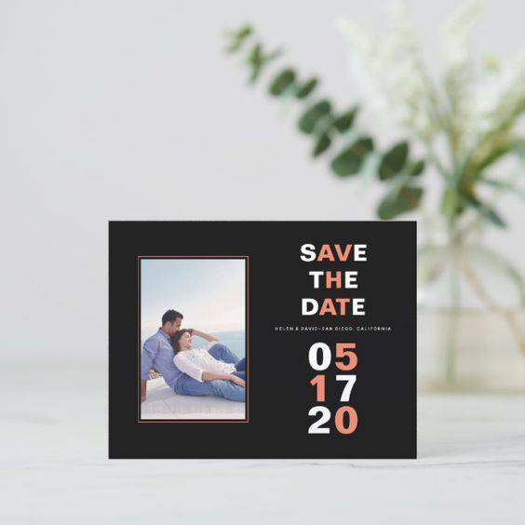



CREATE AN
EVENT
Choose an audience
Choose a budget
Invite people to the event (when they click interested, their friends see too)
Post edited photos and before-and-after shots, and post regularly with countdowns
RESERVE YOUR SEATS
PRODUCTS
BIOCOMPATIBLE CARE
HIGH-END
Notes:
Canva link for VIP story visual: (Create a copy of the document BEFORE editing. DO NOT MODIFY THE ORIGINAL)
https://www.canva.com/design/DAFtIW44kDM/dxlNeFZqD4lRU1Dlz74ftw/edit?utm_content=DAFtIW44kDM&utm_campaign=designshare&utm_medium=link2&utm_source=sharebutton

Slide 22


CANVA LINKS
Create a copy of the document BEFORE editing.
DO NOT MODIFY THE ORIGINAL
Canva link to a Story-format visual:
https://www.canva.com/design/DAFuiwJPqjw/qXIN9g_w8cXKK5TPWfusWg/edit?utm_content=DAFuiwJPqjw&utm_campaign=designshare&utm_medium=link2&utm_source=sharebutton
Canva link to a publication-format visual:
https://www.canva.com/design/DAF_gJgdfP0/2ED4uoKjGk208p5h2R4qGA/edit?utm_content=DAF_gJgdfP0&utm_campaign=designshare&utm_medium=link2&utm_source=sharebutton

Slide 23

KEY MESSAGES
Named Best Canadian Brand in May 2023
Femal Canadian Patent
Instant and long-lasting results
More effective than technology
Based on the science of skin flora
Living care for living skin
A treatment based on freshly released probiotics

Slide 24
GET PREPARED
Visit the portal for beautiful images
Think about gifts of presence/shooting + sponsorship + gifts with purchase/shooting
Order your inventory of products for sale and gifts with purchase
Plan who does what (employees, friends, spouse)
Someone to take photos (now's the time to build up a bank of beautiful photos of yourself, your institute and your products, and show that there's a crowd!
Plan who's going to close the sales!
Prepare your recommendation sheets for each customer, with basic products, and leave them on the table.
Prepare your paper invoices
Prepare your price lists
Master the subject, more knowledge = more confidence = more sales!
Make it smell good!
Provide bubbles 1 glass per person
Plan the date of your next VIP

Slide 25

Women's clothing boutiques Natural products stores
Hairdressers
Manicurists
Massage therapists
Spa
Yoga centers
Gym
Restaurants
Caterers
Florists
SPONSORSHIPS

Slide 26
DURING THE EVENING
Get them involved and ask questions!
Make people laugh; laughter increases information retention
Make people touch and feel; use the senses!
Run through the products used in order for Care, giving key words
How and when to use them (group pre-consultation)

Slide 27
SAVE TIME
Be strategic ;-)
Review the recommendation they have on hand and motivate them to add products they would like for themselves or their family (e.g. eczema balm).
Give examples, share usage tips ++.
Quickly introduce other Davincia collections
Present your gifts with purchase in front of everyone

Slide 28
SET THE DATE FOR THE NEXT VIP
ALWAYS PREPARE FOR THE NEXT VIP and offer your customers priority
(pass on a pre-booking list for them to enter their names)
Ask them to invite friends to share the good news!

Slide 29
THE NEXT DAY
Hold your door prize draw live on your RS
Give them an opportunity to come back to your institute to pick up their gift
Make those who couldn't come salivate so they'll book the next date
Share the date of the next VIP to register there!

